Slide 2
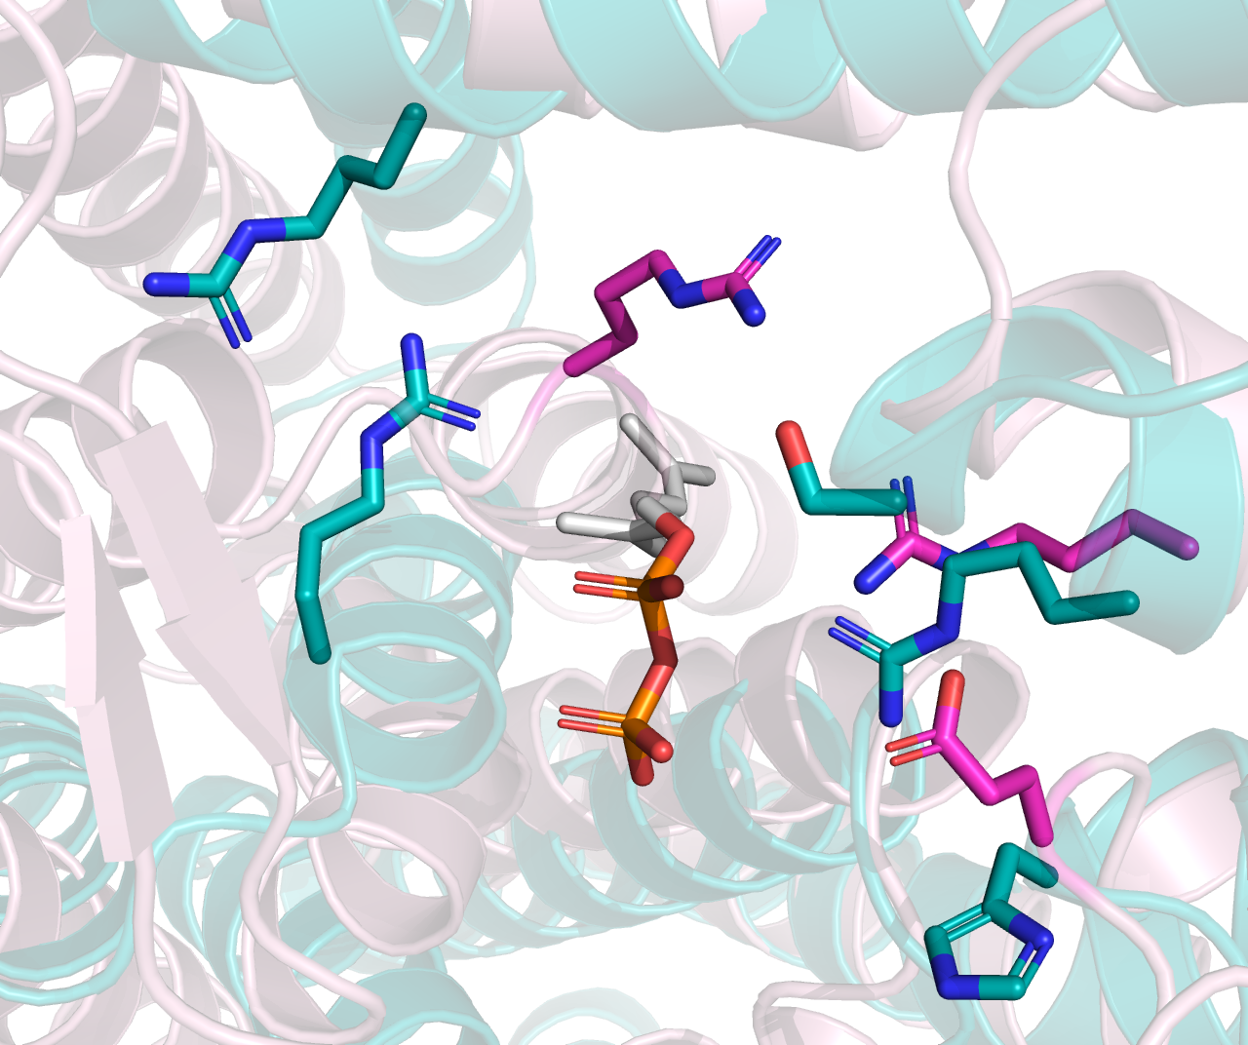
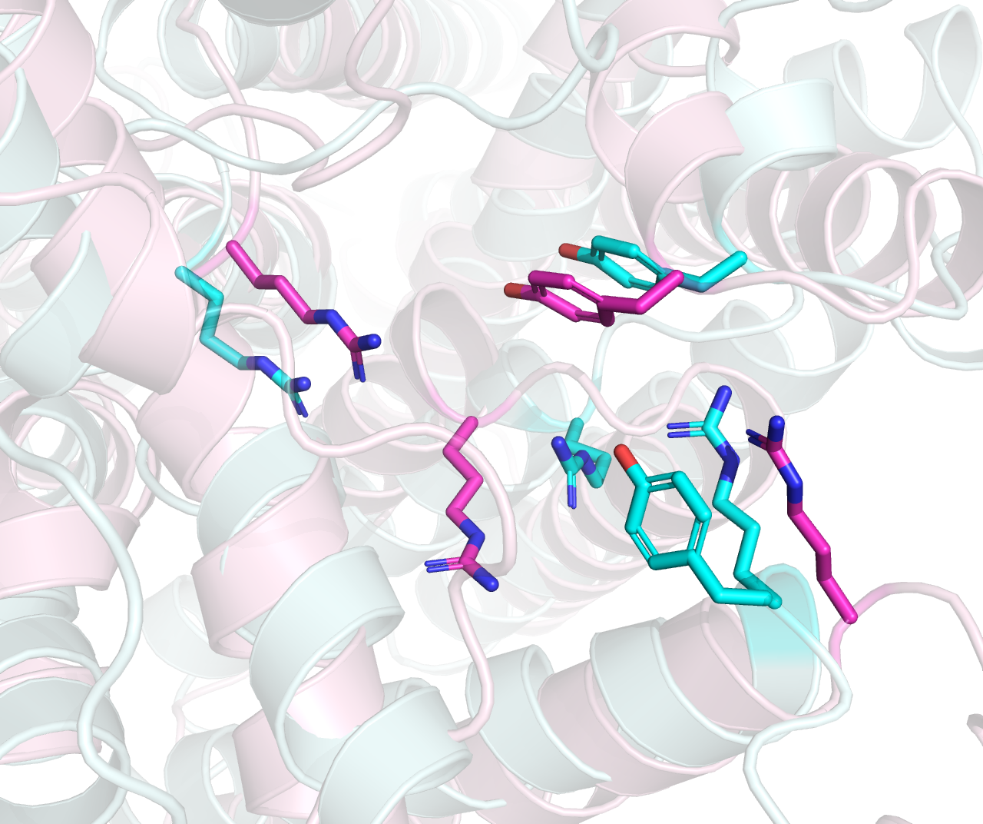
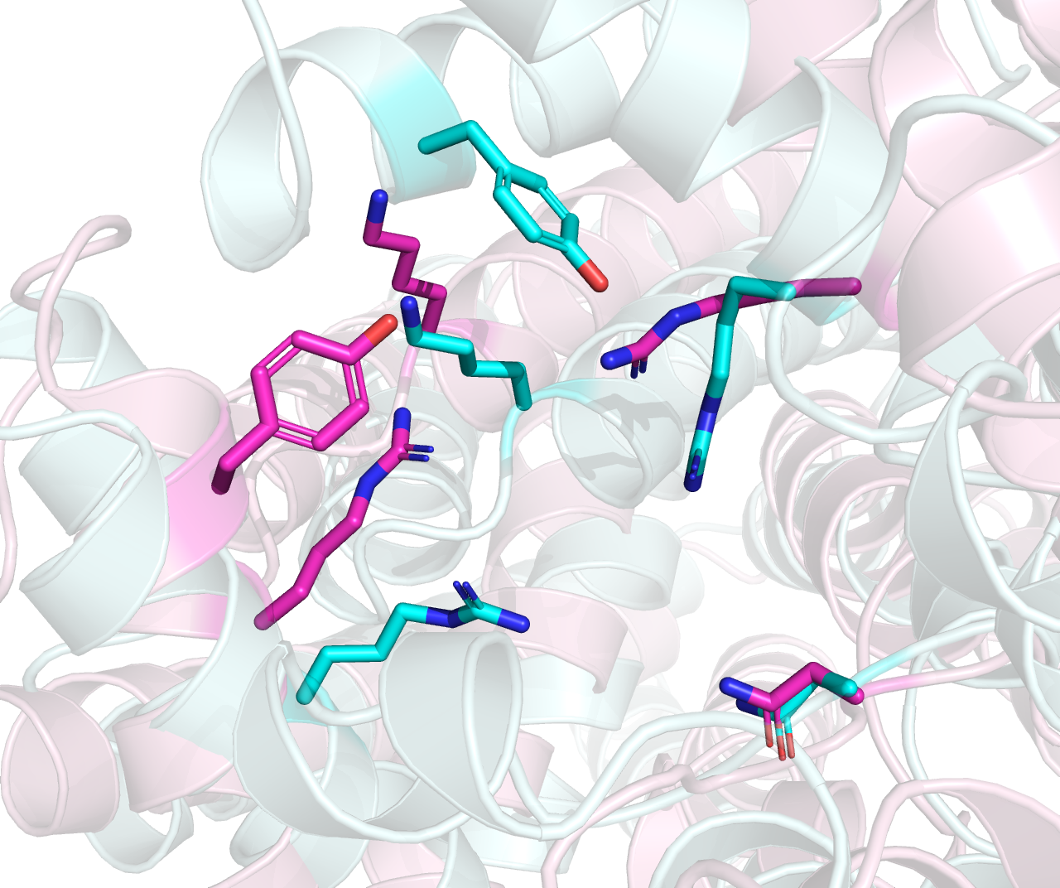
Cyan: 615, O-Lig. Pink: 614, O-Pol
Cyan: 586, ECA-Pol. Pink: 608, O-Pol
Cyan: 606, O-Pol. Pink: 611, O-Pol

Slide 3
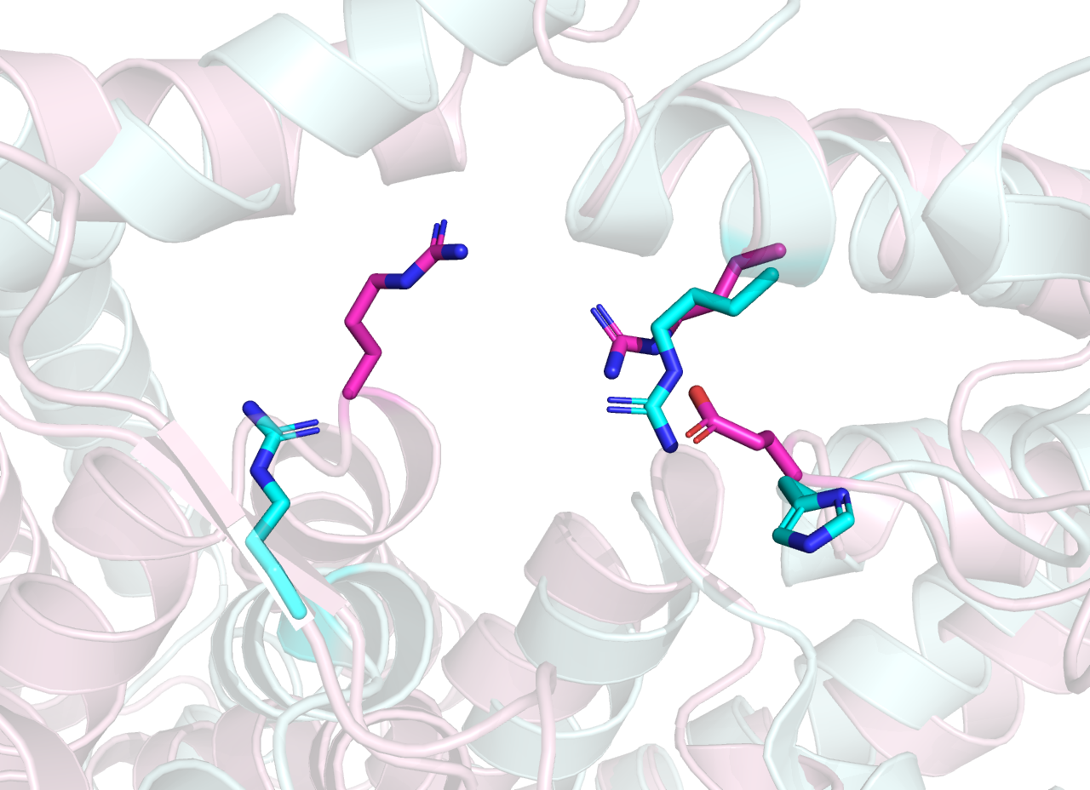
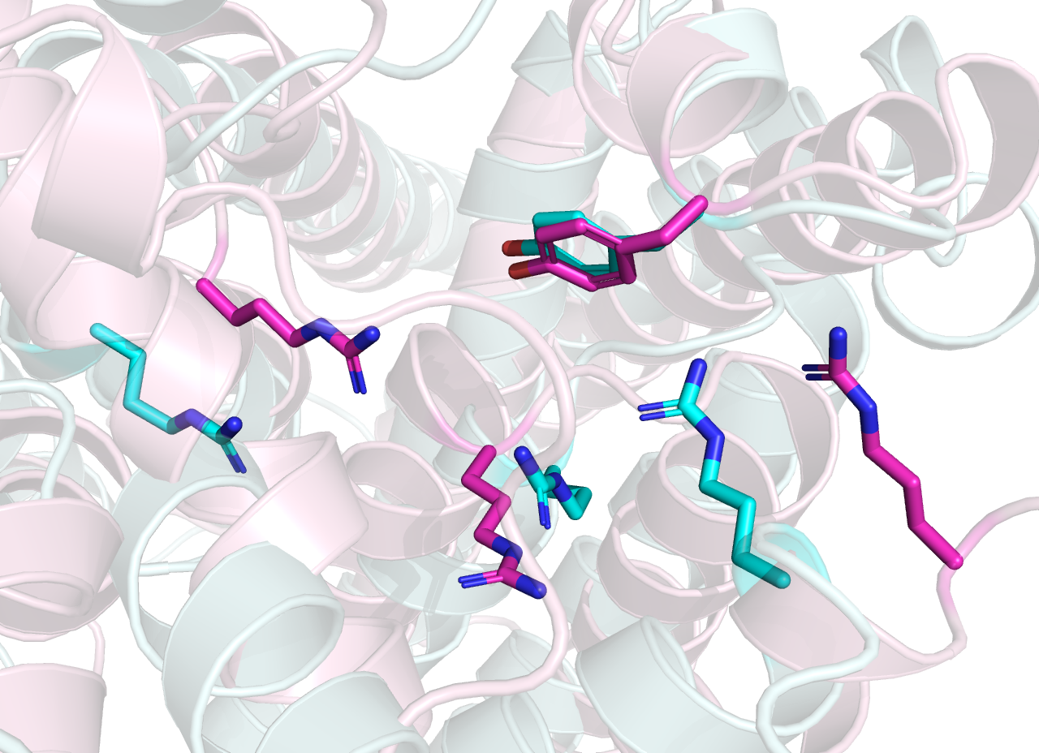
Cyan: 615, O-Lig (7TPG). Pink: 614, O-Pol
Cyan: 586, ECA-Pol. Pink: 608, O-Pol

Slide 4
Cyan: O-Lig, GTxx3 (7TPG)
Pink: BP-Pol, GTxx8 (AAM27615.1)
Cyan: ECA-Pol, GTxx2 (ACH50550.1)
Pink: BP-Pol, GTx16 (CAI32772.1)

